Slide 1
Mediger
A Medication Alarm Service With AI Speaker
2019. 12. 12 / Light is LED

Slide 2
INDEX
01 Background
02 Mediger
- Overall Architecture
- Mediger with NUGU speaker
- Mediger with Mobile App
03 Conclusion

Slide 3


01 Background
Elderly with
Chronic Disease
89.5%
Having high blood pressure and diabetes, I was prescribed medicine at different hospitals. But one day, I passed out and was taken to the emergency room. The reason was low blood sugar shock from over-dose. It's because I couldn’t follow up with the confusing dosage instructions.
Number of Medicine in Take
정모씨 (70)
Average
4.1

Slide 4
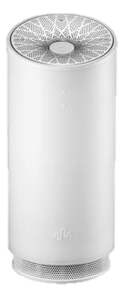
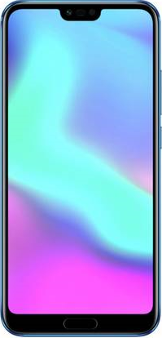




01 Background
A. Service Platform
Platform 1) SKT NUGU Device
Platform 2) Mobile Application
B. Service Mechanism
Sign up
Register Medication
Alarm
Check Taken

Slide 5

02 Mediger Overall Architecture
01 Front
Receives the user’s request, forwards it to the server, processes the response
Intuitive color and icon design
Javascript and React.js
02 App Server
NUGU Device Request
Receives a request from the user and provides the appropriate response
Interacts with the Database in this process to find, create, update, and destroy data.
User
Javascript and Node.js
Mobile App. Request
03 NUGU Play
Receives the user’s request, forwards it to the server, processes the response
Play Builder

Slide 6
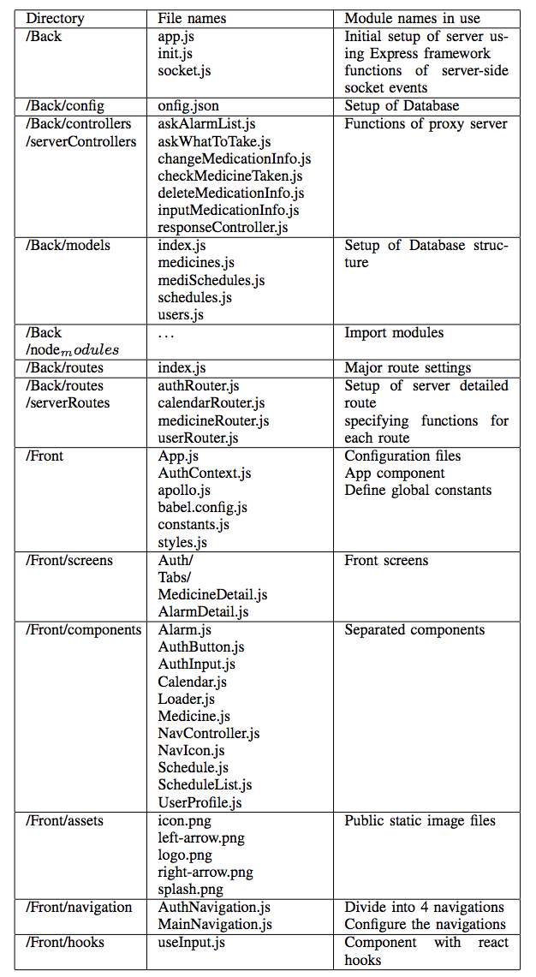
02 Mediger Directory Organization
01 Front
02 Back
03 NUGU Play
04 Document

Slide 7
02 Mediger with NUGU Speaker
01 Alarm Setter
Alarm setter could pass alarmName, medicineName, dosage, endDate and alarmTime as utterance parameter.
User ID is asked in every NUGU use cases

Slide 8
02 Mediger with NUGU Speaker
02 Medicine List Asker
This is the case in which the user wants to know the medicine list he or she has taking now.
Depending on the utterance parameters, it responds by telling today’s medicine list, or medicine list for a specific date, or all medicine list.

Slide 9
02 Mediger with NUGU Speaker
03 Alarm Asker
This is the case in which NUGU notify the user of the medication to be taken.
However, there is a limitation for implementing alarm function in NUGU Device. Therefore, the user should ask what medicine he or she would take now.

Slide 10
02 Mediger with NUGU Speaker
04 Medicine Taken Checker
This is the case in which the user checks the medication has taken or not. It responds by telling taken medication name and not taken medication name.

Slide 11
02 Mediger with NUGU Speaker
05 Alarm Changer
Alarm Changer could choose which alarm he or she wants to change by entering the alarm name. Then, Alarm Changer would choose the category to change among end date, alarm time or medicine name. If the medicine name selected to be changed, the dosage should be changed as well.

Slide 12
02 Mediger with NUGU Speaker
06 Alarm Deleter
This is the case in which the alarm is deleted.

Slide 13
02 Mediger with Mobile Application
01 Alarm Register

Slide 14
02 Mediger with Mobile Application
03 Calendar Page

Slide 15
02 Mediger with Mobile Application
03 Medicine List Page-Register an Alarm

Slide 16
02 Mediger with Mobile Application
03 Medicine List Page-Register an Alarm

Slide 17
02 Mediger with Mobile Application
05 Medicine List Page-Get an Alarm Information

Slide 18
02 Mediger with Mobile Application
06 Medicine List Page-Update an Alarm Information

Slide 19
02 Mediger with Mobile Application
06 Profile Page-Get User Profile

Slide 20
02 Mediger with Mobile Application
07 Profile Page-Update User Profile

Slide 21
03 Conclusion
Difficulties
Connection between front and app server
When the app tried to communicate with the app server using fetch(), there were many unexpected issues. While we were working with these issues, we found out that SSL security protocol is needed. Even, depending on the coverage or Android version, the same SSL results different errors. So we're going to work this out until the last submission date.

Slide 22
THANK YOU

